Slide 1





Pune Smart City Environmental Sensor Data Analysis (2019)
Exploratory Data Analysis using Smart City Environmental Sensor Data

Slide 2
Agenda
Problem Statement
Dataset Overview
Features Classification
Univariate Analysis
Bivariate & Correlation Analysis
Spatial & Temporal Analysis
Key Insights & Risks
Recommendations
Conclusion

Slide 3
Problem Statement
Pune faces increasing air pollution due to:
  Rapid urbanization
  Traffic congestion
  Industrial & commercial activity
City authorities need data-driven insights to:
  Identify pollution hotspots
  Understand pollution behavior over time
  Take targeted corrective action

Slide 4
Dataset Overview and Feature Classification
Dataset: Pune Smart City Environmental Sensor Dataset (2019)
Records: 103,205
Features: 28
Data Type: Time-series + Location-based sensor data
Source: PSCDCL & IISc Bangalore
Location Data: Name, Latitude, Longitude
Air Pollutants: PM2.5, PM10, NO₂, CO, SO₂, Ozone
Environmental Parameters: Temperature, Humidity, Sound, Light, Air Pressure
Time Feature: Timestamp, Hour, Day, Weekday

Slide 5
Data Cleaning and Preprocessing
Handled Missing Values.
Removed zero & unrealistic sensor readings.
Treated outliers using IQR method.
Converted timestamp into meaningful time features.

Slide 6
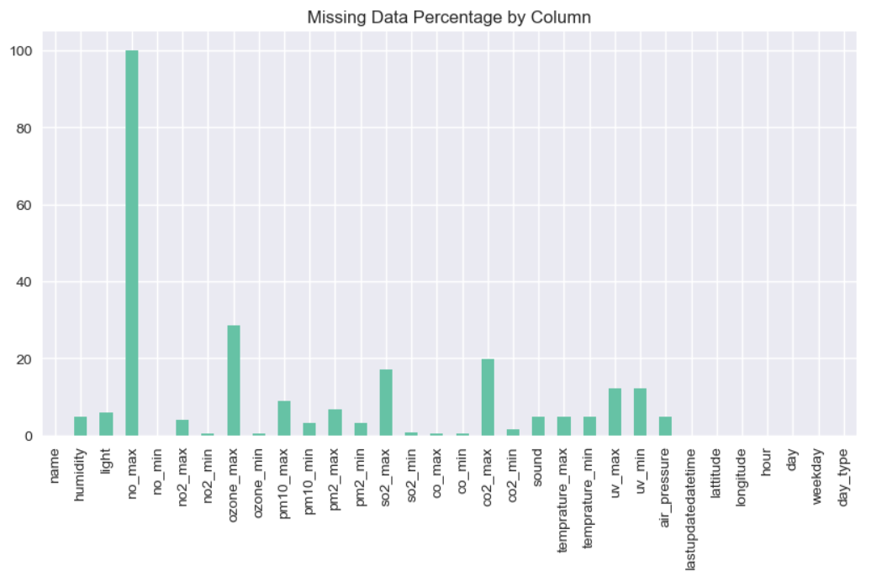
Data Quality Assessment
Some pollutant sensors showed higher missing values.
PM2.5 & PM10 had the most quality issues.
Environmental parameters were relatively stable.

Slide 7
MONITORING LOCATIONS ANALYSIS
Multiple monitoring locations across Pune.
Few locations contributed most readings.
Uneven sensor coverage observed.

Slide 8
DISTRIBUTION OF KEY AIR POLLUTANTS
PM2.5 and PM10 show right-skewed distribution.
Frequent high pollution episodes.
Presence of extreme values.

Slide 9
ENVIRONMENTAL FACTORS DISTRIBUTION
Temperature and Humidity shows normal trends.
Sound and light indicate urban activity patterns.

Slide 10
VARIABILITY ANALYSIS
PM2.5 and PM10 show highest variability.
Indicates uneven pollution exposure across Pune.

Slide 11
CORRELATION ANALYSIS
Strong correlation between PM2.5 and PM10.
CO and NO₂ correlated – Traffic impact.
Environmental factors moderately influence pollutants.

Slide 12
AQI PRIORITY PARAMETERS
Top 5 parameters to monitor:
  PM2.5
  PM10
  NO₂
  CO
  Ozone

Slide 13
SPATIAL ANALYSIS – POLLUTION HOTSPOTS
Clear pollution hotspots identified.
Transport hubs and dense areas most affected.

Slide 14
TEMPORAL ANALYSIS
Pollution peaks during morning and evening hours.
Weekdays shows higher pollution than weekends.
Strong link with human activity.

Slide 15
MOST POLLUTED LOCATIONS
Ranked top 5 polluted locations.
PM2.5 and PM10 exceed safe limits most frequently.

Slide 16
STABILITY ANALYSIS
Some location shows stable pollution.
Others show high fluctuation – risk zones.

Slide 17
CLUSTERING LOCATIONS
Locations clustered into :
  High pollution
  Moderate pollution
  Low pollution
Helps in targeted interventions.

Slide 18
Thank You !

